Slide 1
DA, LLC
Presented by:
Joseph Tsiyoni,
Founder & CEO
Rob Loy, Former V/P Technology (Former)
YouTube: https://www.youtube.com/watch?v=YskdSz7k894
(Doesn’t open? Copy and Paste above or below lines): http://www.youtube.com/watch?v=YskdSz7k894&feature=youtu.be

Slide 2



*One Ad - 1 Location
*Two ads Max in 12 Hours
*Unregistered users
Spam, Fraud, Scam
*$75 - $5/ Ad
*Keeps Adding Fees
Problem (CL & Auctions)
1. Craigslist:
2. eBay (250M Ads/Year) & All Auctions: High Fees & Charges
Unknown Responders
Unwanted
Pornography
Unregistered Abusers!
Adverse Consequences!

Slide 3

●$1 Ad, Anywhere, Anytime, Instantly
●Registered Users Only
●Safer, More Secure, Trustworthy
●Entrepreneur Haven: IP Global Hub:
Patents, Inventions, Ideas
Trademarks, Tradenames, Copyrights
Business & Partnerships Opportunity
Joint Ventures – VC
Dollars-Ad Solution

Slide 4
Traction
Site Needs Update
Active Team of Experts
People Are Waiting For a Safer, Truthful Site

Slide 5
Market Opportunity
CL + Newspaper Market Is Huge:
*Sharing $1.3 Bill. CL & eBay ADS!
*Sharing $17 Bill eBay & CL. Paid ads
*Sharing $12 Mil CL. Job Posting
*Sharing Newspaper Market *Aimed To Become IP Global Hub
*Employment – Jobs Hub @ $1
*Beating CL $75 -$5/ Ad [@ $1 only!]

Slide 6
Business Model
Customers: Registered Users Only Individuals Advertisers Businesses Employers Dealers: Cars, Goods CL advertisers Cost: Future: Based on revenue & Expansion | Operation: LLC Formed Operational Web Sales & Marketing P.R., Networking Own Server, Hosting, Maintenance Legal, TM, TN: All completed

Slide 7
Competitive Advantage
1: Craigslist.org
DA OPERATION
(1 Bill. Ads / Year): CL Has Troubling Adverse Issues
ADS Anywhere,
Anytime, Instantly
“Free” Became $75 / Ad
Registered Users Only
Adding & Increasing Fees
Safer, More Credible
Spams, Fraud, Crimes
Unlimited Posting
2: eBay + Auctions:
High Fees & Charges
Employment Hub
3. Newspapers
IP GLOBAL HUB:
Shrinking constantly: Too Expansive, Tiny Print, Ineffective
Patents, Trademarks, TN,
Copyrights, JV (Joint Venture), Businesses 4 Sale

Slide 8
Marketing & Sales Strategy
------------------------------------------------------------------------
DA, LLC
U.S. Marketing
Partners Team
India Marketing Partners
CEO & V/P Conduct
Special Sales & P.R.
Indian Partners Conduct Intensive Sales & Marketing
Press Release; Emails,
Networking
Telemarketing
Special Businesses

Slide 9
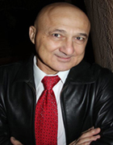
Management Team
Joseph Tsiyoni, CEO
●B.A. - Pub. Admin, Law; Accounting, MS, Web Design
●Experience Executive Auditor, HR Dir., Analyst –28 Yr.
●Recipient of dozens of efficiency awards
●Inventor, manufacturer, author of 16 books
●Owner, S.I.T. invention company – 25 years
●CEO & President, PrideR, LLC prider.net
●Owner, SofiDent, Import & Distribution – 19 years
●Founder, CEO, DA, LLC, Dollars-Ad.com
V/P Technology & Services
● VACATED
Marketing Partner
●To be announced.

Slide 10
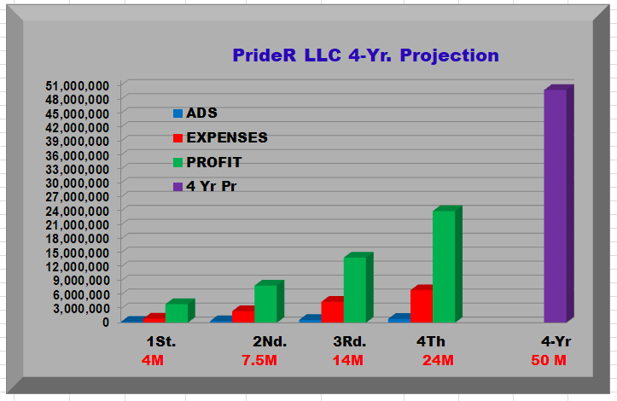
!
Financial Summary & Projection

Slide 11
Investment & Exit Summary
INVESTMENT
EXIT & ROI
Valuation: $3,000,000
Ownership: 40%
●Investment: $1,500,000
● OPERATIONS:
Website Completion
Marketing
IT Services, Security
Maintenance & CEO
Miscellaneous
●M&A: Preference for
Acquisition when the LLC
grew substantially
●Merger will be considered
●E.g.: eBay purchased
25% shares of CL
●Do to new BUS Model,
significant growth will
increase acquisition
interest

Slide 12
Thank you for your time!
Questions?
Joseph Tsiyoni
CEO@Prider.net & Tsiyoni@cox.net
480-949-0894
www.Dollars-Ad.com
IP Global Hub Is A
Significant Alternative To CL
Faster Growth Will Prevail
Despite The Modest Projection

